Slide 1
Modern .NET development with SQL Server
@ErikEJ

Slide 2
Challenges?
Database schema not in source control
Complex scripts to update schema
Versioning of database vs app a nightmare
Runtime errors in database due to uncaught syntax errors
No standard approach to naming or other database design ”business rules”
No qualified review of schema design
No cross platform build and deployment support
No proper NuGet integration

Slide 3
Process
Create / import .sql scripts
Build & Analyze
.dacpac
Deploy
Create SQL project

Slide 4
Tooling
Create / import .sql scripts
Build & Analyze
.dacpac
Deploy
Create SQL project
Visual Studio
VS Code
sqlpackage extract
dotnet new
Azure DevOps pipelines
GitHub actions
sqlpackage publish
MSBuild
dotnet build
dotnet pack Analyzer rules
DacFX

Slide 5
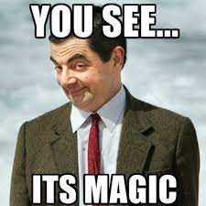
Why .dacpac?
Ensure high quality and consistent SQL schema under source control
Enforce design, performance, naming and security rules
Desired state configuration
Publish magic!

Slide 6
Demo!

Slide 7
sqlpackage
DacFx
SqlScriptDom
SqlClient

Slide 8
MsBuild.Sdk.SqlProj.Templates
Project and item template for MsBuild.Sdk.SqlProj projects
dotnet new install MSBuild.Sdk.SqlProj.Templates

Slide 9
MsBuild.Sdk.SqlProj
SDK for building .dacpacs with full NuGet support
NuGet: Reference other .dacpac
NuGet: Reference analyzer rules
<Sdk Name="MSBuild.Sdk.SqlProj" Version="3.2.0" />
Microsoft alternative (less features and no VS support): Microsoft.Build.Sql

Slide 10
ErikEJ.DacFX.SqlServer.Rules
Rule sets with 140 rules for inclusion in SQL Database project
dotnet add package ErikEJ.DacFX.SqlServer.Rules
(also ErikEJ.DacFX.TSQLSmellSCA)

Slide 11
ErikEJ.DacFX.TSQLAnalyzer
Add add-hoc SQL CREATE script analysis to your own .NET app
dotnet add package ErikEJ.DacFX.TSQLAnalyzer

Slide 12
ErikEJ.DacFX.TSQLAnalyzer.Cli
T-SQL Analyzer is a command line tool for identifying and reporting the presence of anti-patterns in T-SQL scripts.
dotnet tool install --global ErikEJ.DacFX.TSQLAnalyzer.Cli

Slide 13
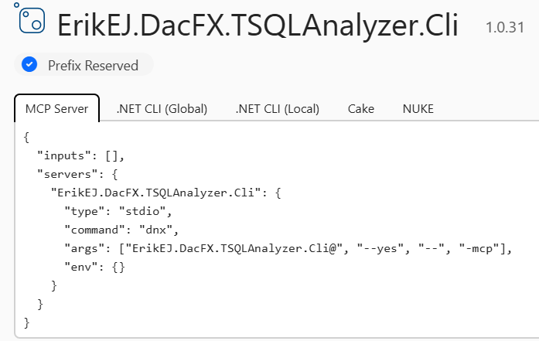
ErikEJ.DacFX.TSQLAnalyzer.Cli
MCP Server to help improve your design with GitHub Copilot or other AI clients

Slide 14
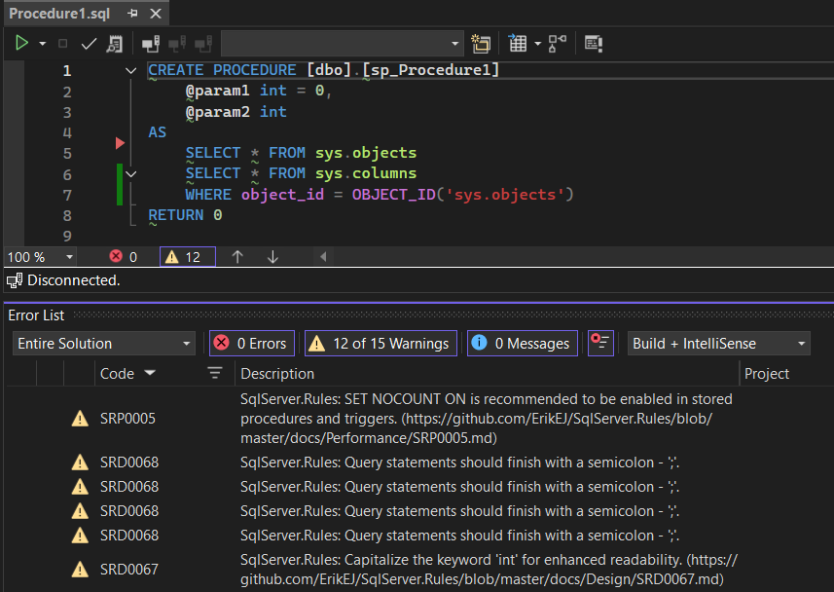
T-SQL Analyzer Visual Studio extension
Analyze your SQL object creation scripts as you type, and get suggestions for improvements based on best practices. The analyzer has over 140 rules covering performance, security, maintainability, and more.

Slide 15
CommunityToolkit.Aspire.Hosting .SqlDatabaseProjects
Host integration for .NET Aspire SQL Database project deployment
dotnet add package CommunityToolkit.Aspire.Hosting.SqlDatabaseProjects

Slide 16
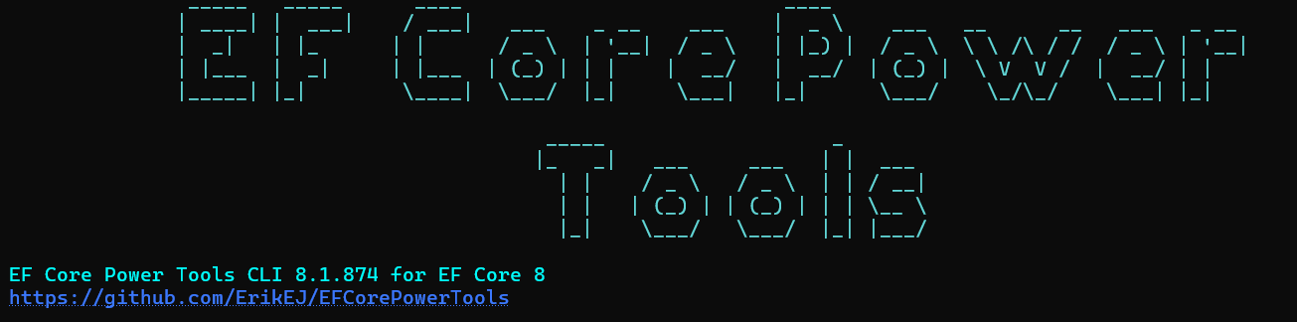
ErikEJ.EFCorePowerTools.Cli
Command line tool for advanced EF Core reverse engineering – also from a .dacpac

Slide 17
SQL Database Project Power Tools (coming ”soon”)
Import database (MsBuild.Sdk.SqlProj)
Analyze (html output)
Unpack dacpac (deploy.sql)
Compare with other .dacpac
Create Mermaid ER diagram
Data API Builder scaffold
Schema compare (for MsBuild.Sdk.SqlProj)
Power Pack with Templates, Code Analysis, Formatter

Slide 18

CTA
Add you database schema to source control
Enable code analysis locally and in CI
Optional: Create your own rules and contribute them back to the community

Slide 19
Classic .sqlproj vs MSBuild.SDK.SqlProj
 | .SQLPROJ (Legacy VS) | MSBuild.SDK.SqlProj
Create, build, publish a .dacpac | ✔ | ✔
Run Code Analysis | ✔ (15 rules) | ✔ (120+ rules)
Run custom rules | ✔ (admin only) | ✔
Run rules on hosted agent | ✔ | ✔
Run custom rules on hosted agent | ❌ | ✔
Build on Linux (dotnet build) | ❌ | ✔
Visual designers | ✔ | ❌
NuGet pack (.dacpac/rules) | ❌ | ✔
SQL CLR | ✔ | ❌ (workaround)

Slide 20
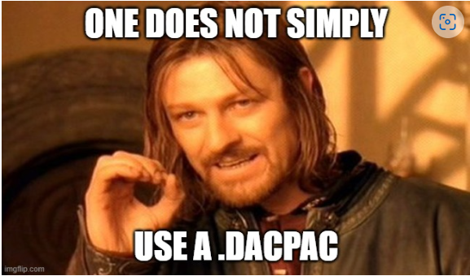
Q & A

Slide 21
Q & A
Handling destructive schema changes?
How do I ”seed data” to my database using a .dacpac?
This is a community project, what is MS doing?
I use Postgres / Oracle /MySQL – can I use this?
Does it work on Azure SQL Databases?
What if I just want to analyze a script on disk?

Slide 22
Q & A
Sharing parts of a database (f.ex. monitoring) ?
What if my db has dependencies on other database?
How would this work with EF Core?
How about .NET Aspire?

Slide 23
What is a dacpac and why should I care?

Slide 24
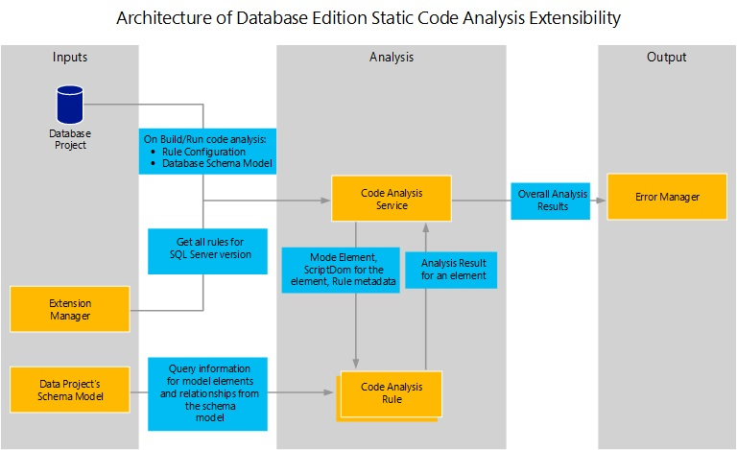

Slide 25
Why?
Data Tier Application Package
Get your database under source control
Ensure your .sql scripts ”build” – code validation
Ensure your .sql scripts follow business rules – code analysis
Deploy changes to the database schema with changes to your app
No more migration scripts – simply describe your desired state
Cross platform build and deployment support

Slide 26

Process
Create .sql scripts
Build
.dacpac
Deploy
Create .sqlproj

